Slide 1
IBM HACKATHON
Web Application for redacting information from the unstructured system.
TEAM NAME: HashCode
COLLEGE NAME: Gyan Ganga College Of Technology
TEAM MEMBERS NAME: Shreya Gupta
Jasmine Kaur Kheterpal
Vishal Agrahari
Suraj Shrestha

Slide 2
PROBLEM STATEMENT:
Design a system or program to identify and redact (mask) sensitive personal information like name, location, age, gender, Aadhaar number etc from unstructured text.
PROBLEM DESCRIPTION:
A large amount of information are exchanged or released daily on the internet. The sensitive nature of the documents may cause a serious privacy threat if the information misleads to wrong hands. Traditionally, data redaction has been performed manually by a group of experts who are able to seclude sensitive information from the documents.
Several regulations exist to make organizations protect the private information of citizens and customers. GDPR in the European Union, HIPAA in the US (Medical domain) and the proposed Data Protection Regulation in India.
In order to comply with these regulations, companies and govt departments will have to spend inordinate amount of resources if they do the personal data redaction manually.
Hence design a ML based solution to automatically identify personal data entities and redact them using a program.

Slide 3
SOLUTION APPROACH
We are creating a Web Application(DOCREDACTOR) which takes the input from the user as a document in different formats like image or text format. If the document is in image form it is first converted into text format after which our application redact important data using Machine Learning algorithm(Watson natural language) from the document uploaded by the user and converted into a scrambled form so that it is not understandable at the server side.
After this two files are generated:-
Redacted document .
Redacted information .
which are stored in user account.

Slide 4
OPEN SOURCE CLOUD
FIREBASE:
We are using FIREBASE for DATABASE & SERVER.
when we upload a project on firebase it provides us with an API which is used to run the project in which our related data is stored in scrambled form .

Slide 5

USE CASE
REGISTER
LOGIN
USER PROFILE
SUBMIT IDEA
CHOOSE FILE
<<extends>>
<<extends>>
USER
ADMINISTRATOR
TEXT FILE
IMAGE FILE
REDACTED FILE
REDACTED INFORMATION

Slide 6
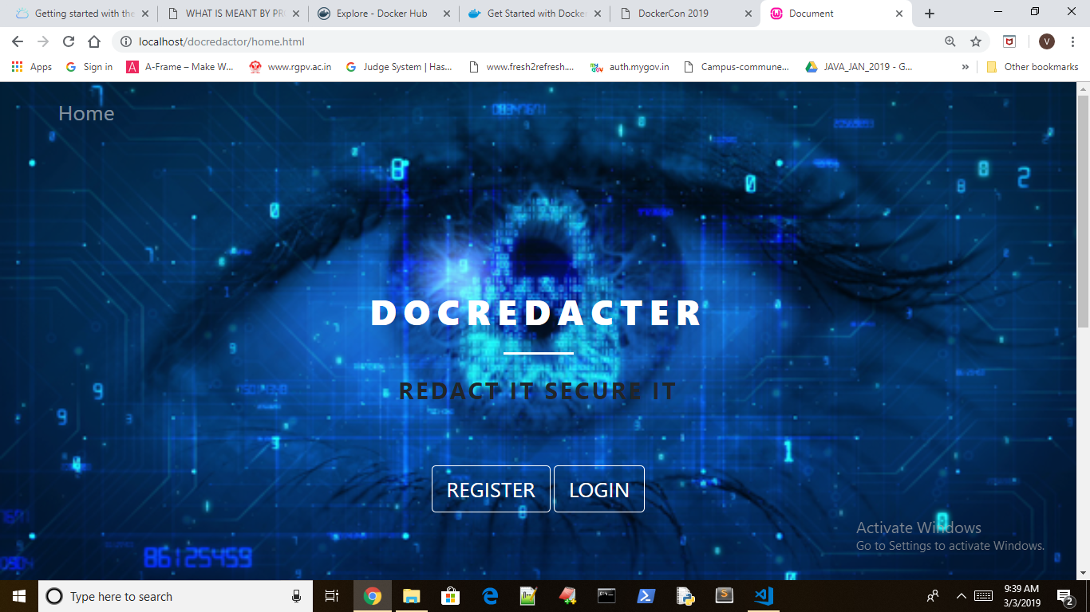
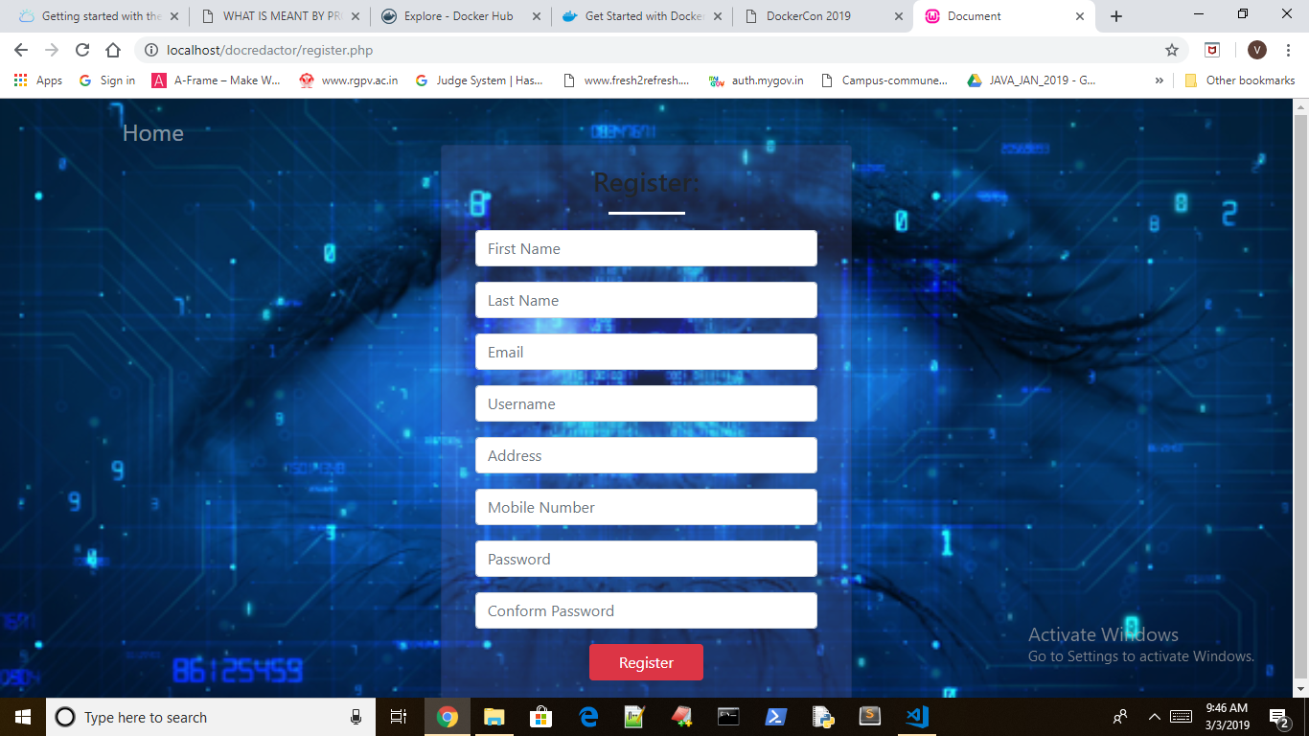
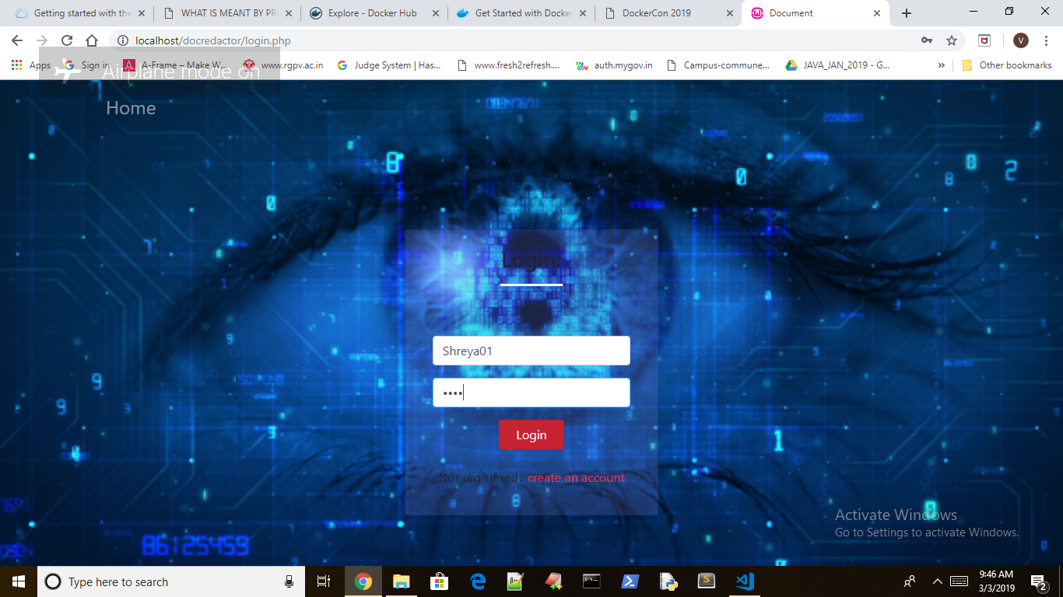
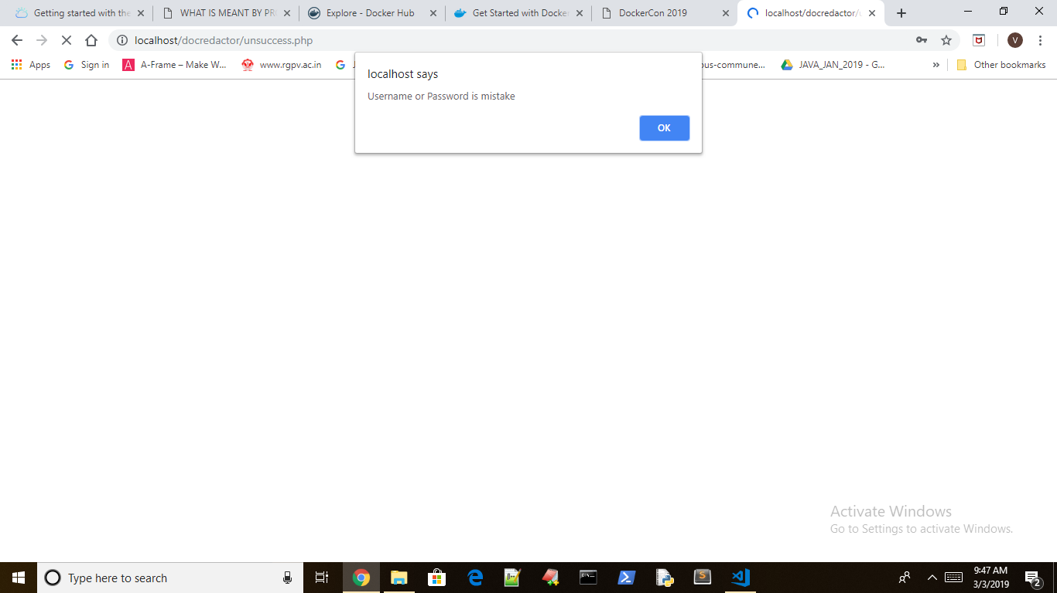
HOME
REGISTER
LOGIN
SUCCESSFUL LOGIN

Slide 7
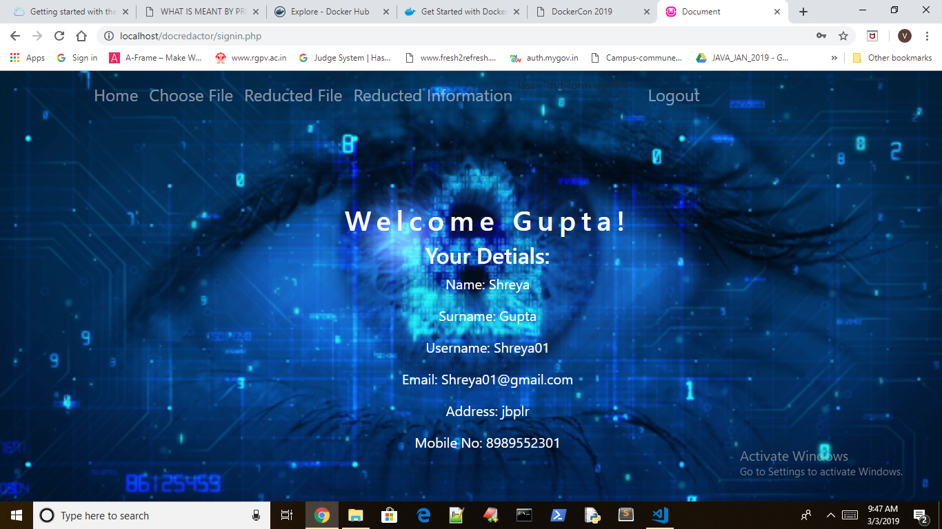
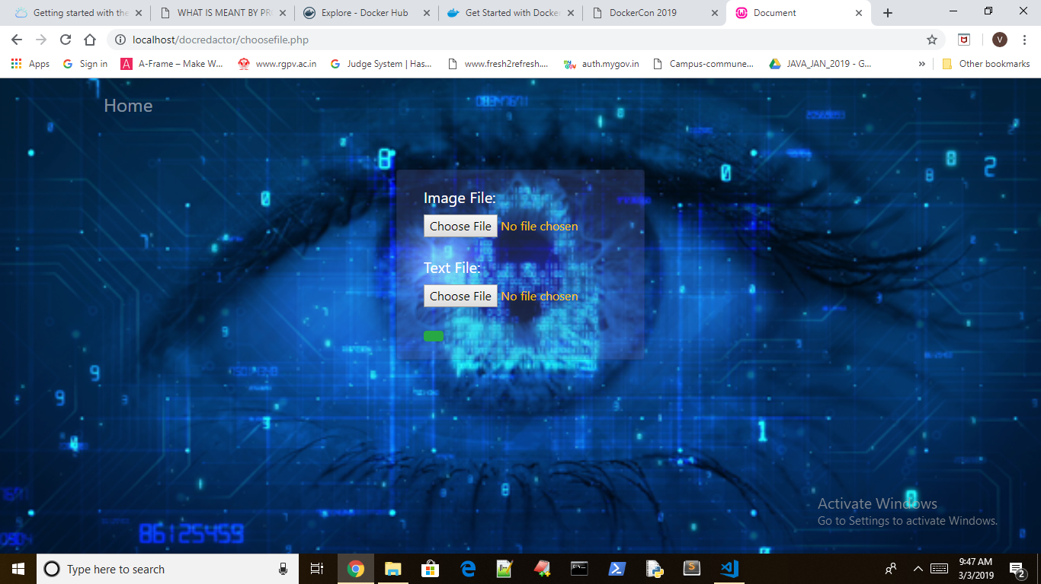
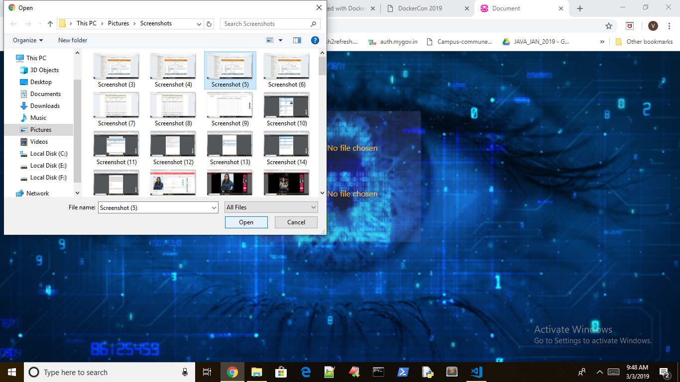
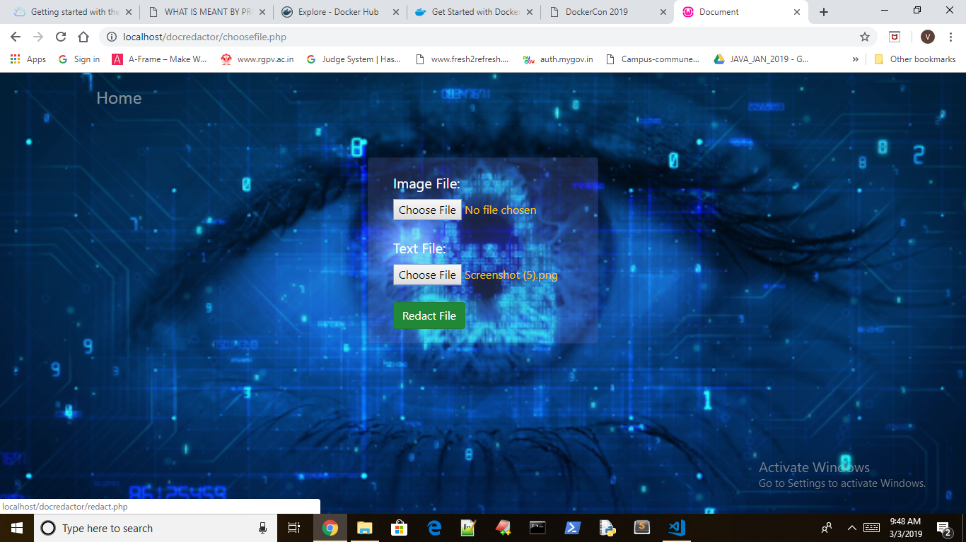
USER PROFILE
UPLOAD FILE
SELECT FILE
REDACT FILE

Slide 8
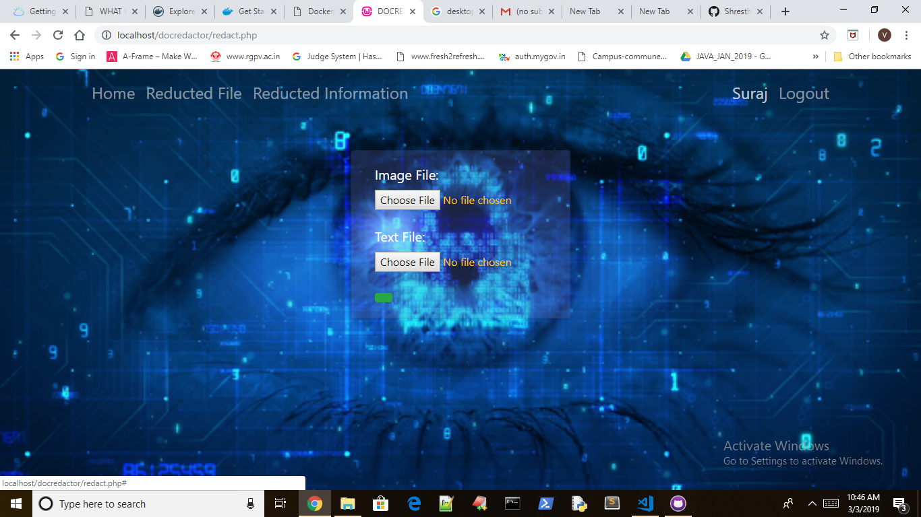
GENERATED REDACTED FILE & INFORMATION
LOGOUT TO HOME PAGE

Slide 9
TECHNOLOGY STACK
FRONT END | BACK END | Machine Learning
HTML | PHP | Python
CSS | SQL | Jupiter Notebook
JAVA SCRIPT | FIREBASE | Watson NLP
BOOTSTRAP

Slide 10
Thank You

